Slide 1

SPEAKER RECOGNITION
By
T.Rahul(EE17B030)

Slide 2
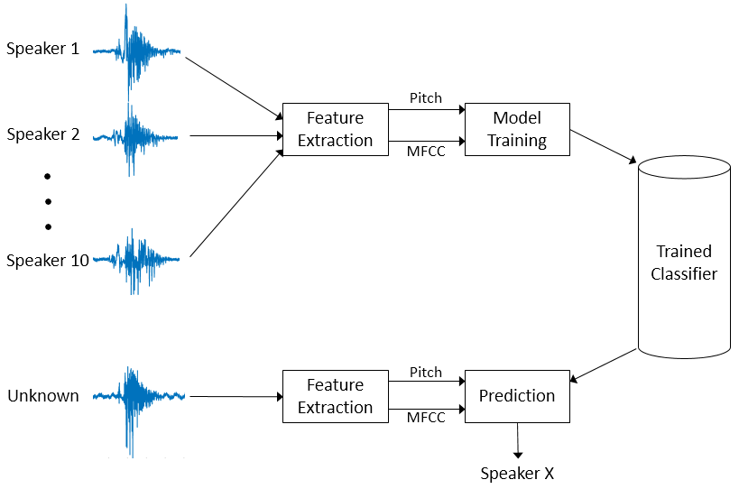
WHAT IS SPEAKER RECOGNITION?
Identifies speaker(in simple words).
How?
We used closed-set speaker identification technique.
Features as MFCC Coefficients.

Slide 3
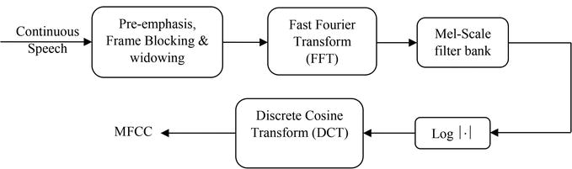
MFCC Feature extraction
Reference: site-1, site-2

Slide 4
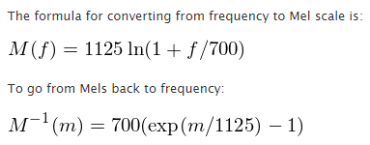
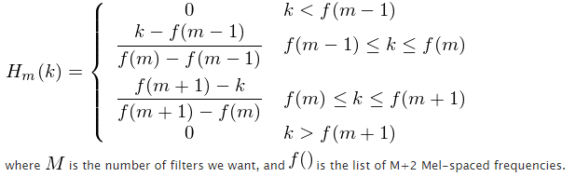
Some important formulae

Slide 5
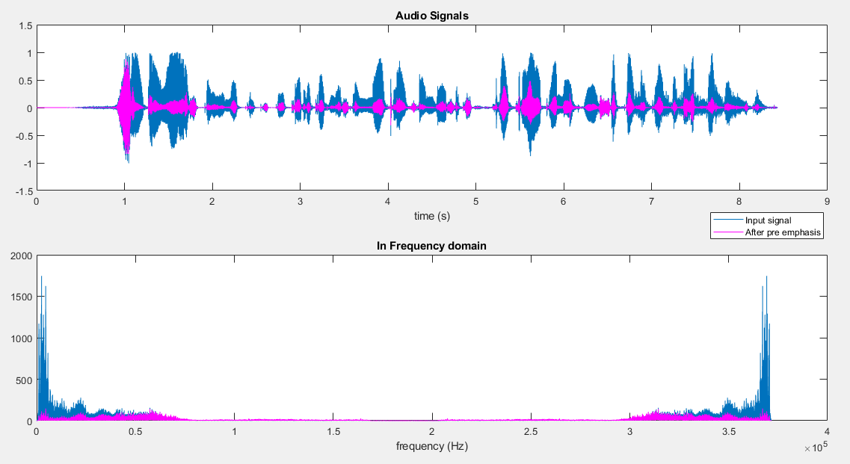
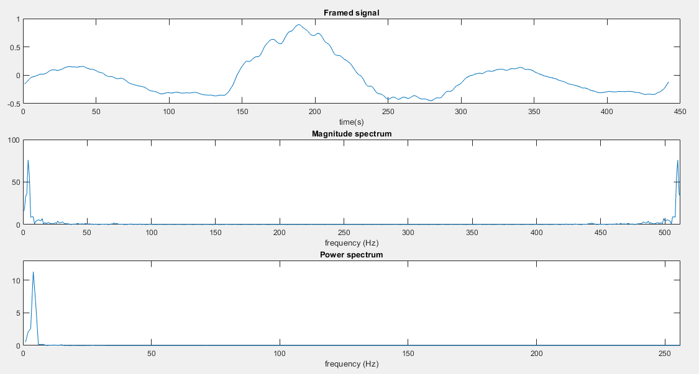
INTERMEDIATE RESULTS IN FEATURE EXTRACTION:
Before and after pre emphasis
For a frame,

Slide 6
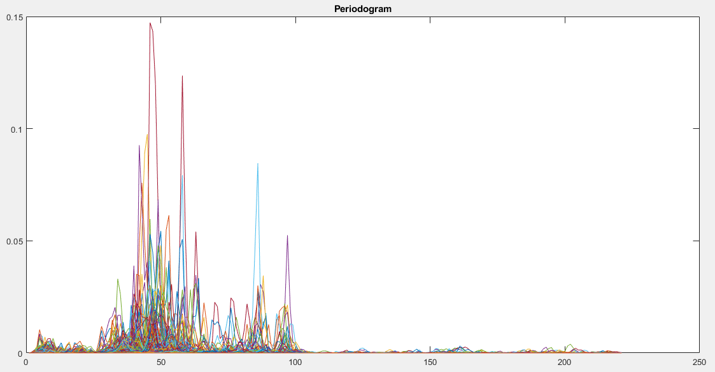
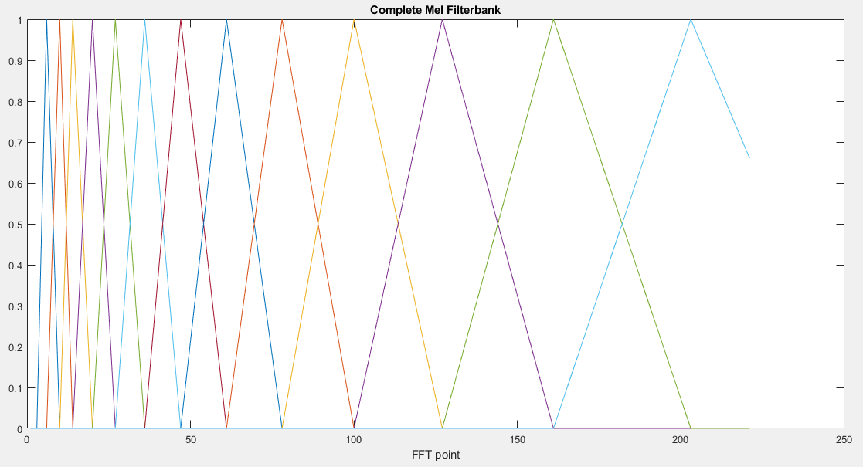
Complete
Power Spectrum
Mel Filter Bank

Slide 7
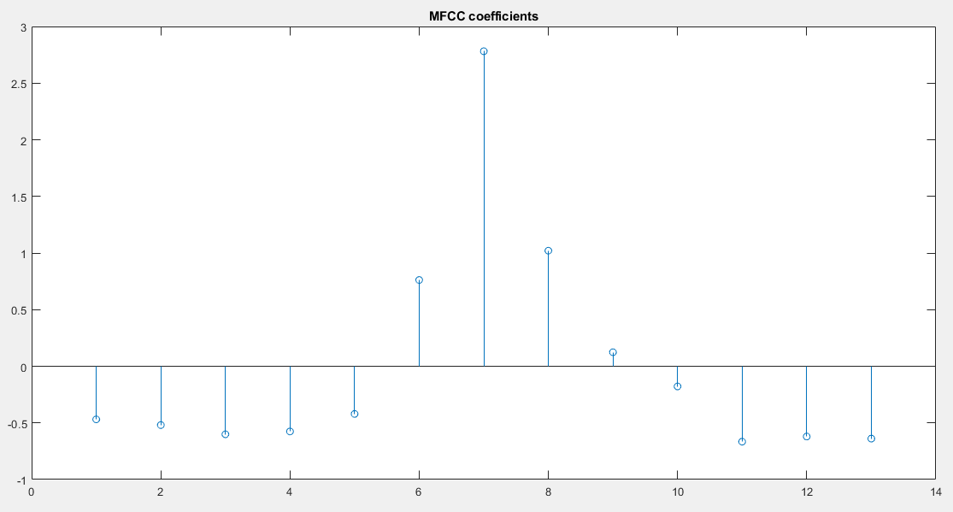
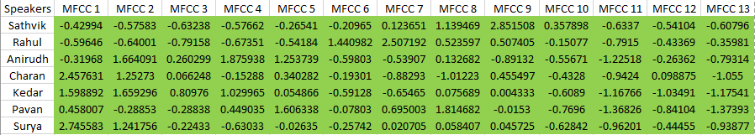
MFCC Coefficients of a single person
MFCC Coefficients for different speakers

Slide 8
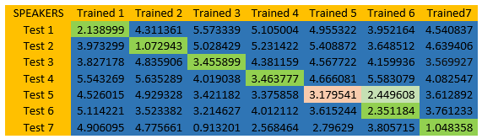
Final results
We identified the speaker according to the minimum distance between unknown and known MFCC vectors.

Slide 9
Observations and Conclusions:
Positive Mel frequency coefficients signify majority of spectral energy is concentrated in low frequency region.
Negative Mel frequency coefficients signify majority of spectral energy is concentrated in high frequency region.
MFCC Coefficients remain same even if there is any noise in the input signals as we are removing it during feature extraction.
Real Life Applications:
Used as home locks by giving access to specified speakers.
Voice activated car engines.
In general, it is used in encrypting important data.
Notes:
Real life applications

Slide 10
THANK YOU

